Slide 1
Final Portfolio Presentation
Wesley Stevens

Slide 2
About Me
Background in Software and Math -> ML Architect
Years of experience in finding solutions to modern problems
Published ML research at Secret DoD Conference
Fun-loving
Fast paced
Motivated by challenge

Slide 3
Agenda
Demonstrate data science skills in major areas
IST 722 – Data Warehousing
Collect, organize, and secure data
Visualize data and assist data-driven decision making
IST 707 – Data Analytics
Identify patterns & develop strategies for a business-usable product
IST 664 – Natural Language Processing
Explore how research has advanced in this difficult subject
Synthesize the ethical dimension

Slide 4
IST 722 – Data Warehousing
Order Fulfillment Team
Courtney Rowland
Wesley Stevens
Jon Burgess
Kejal Vyas

Slide 5
Business Goals and Processes
Fudgemart acquired Fudgeflix and corporate would like both databases converted into a single data warehouse.
Five initial business processes have been identified to meet the companies needs.
Sales
Order Fulfillment
Inventory Levels
Customer Acquisition
Customer Reviews

Slide 6


Project Goals
Merge FudgeMart and FudgeFlix Databases into a Single Data Warehouse.
Create a Bus Matrix for High-level Dimensional Analysis
Detail-Level Dimensional Modeling Worksheet for Order Fulfillment
Create Data Warehouse with Generated SQL Schema
Stage Source Data and Load into Data Warehouse
Gain BI insights into the Order Fulfillment Process
Construct SSAS Cube
Generate BI Dashboard

Slide 7
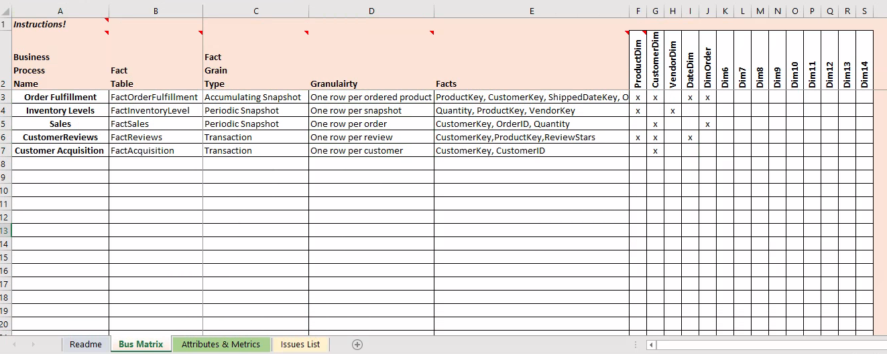
Bus Matrix

Slide 8
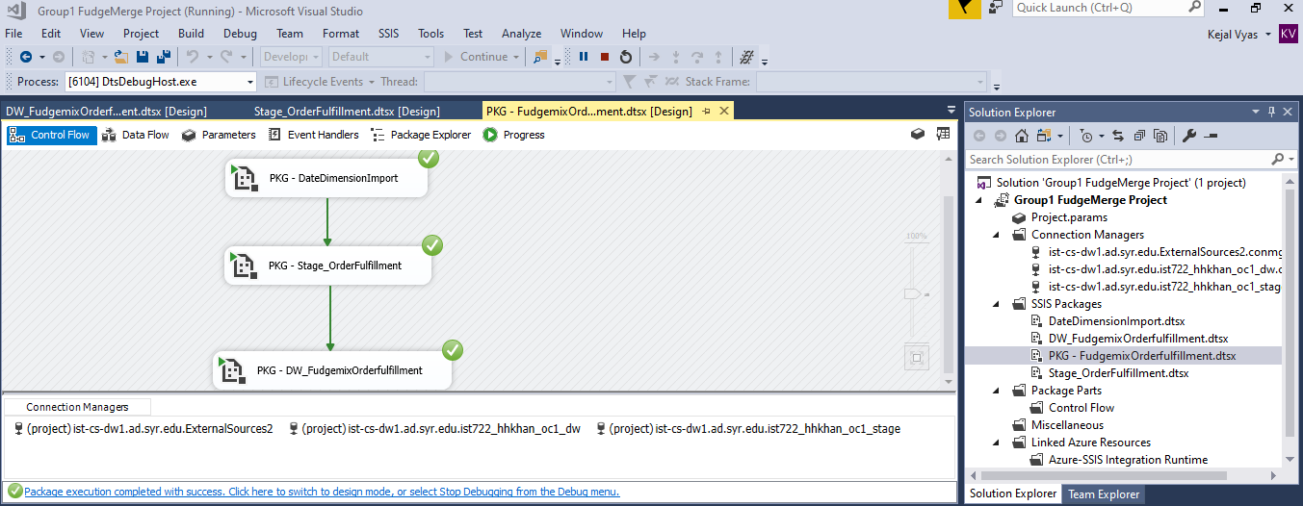
ETL Documentation ScreenShots – Orderfulfill Package

Slide 9
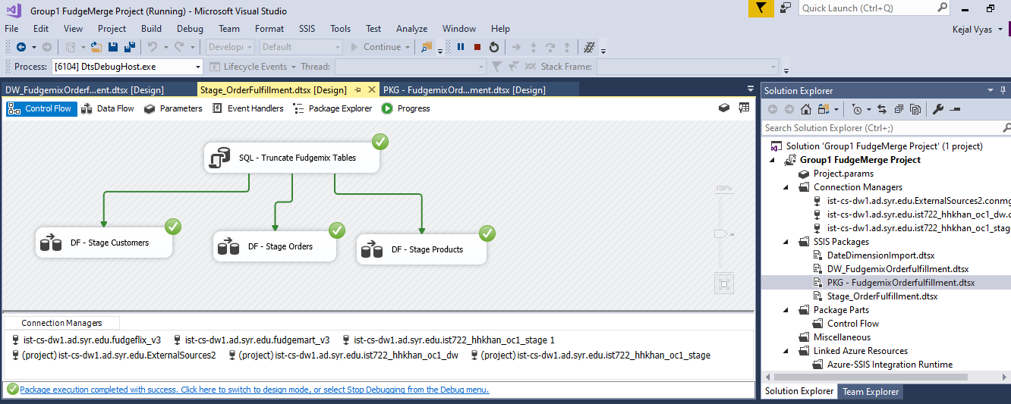
ETL Documentation ScreenShots – Stage

Slide 10
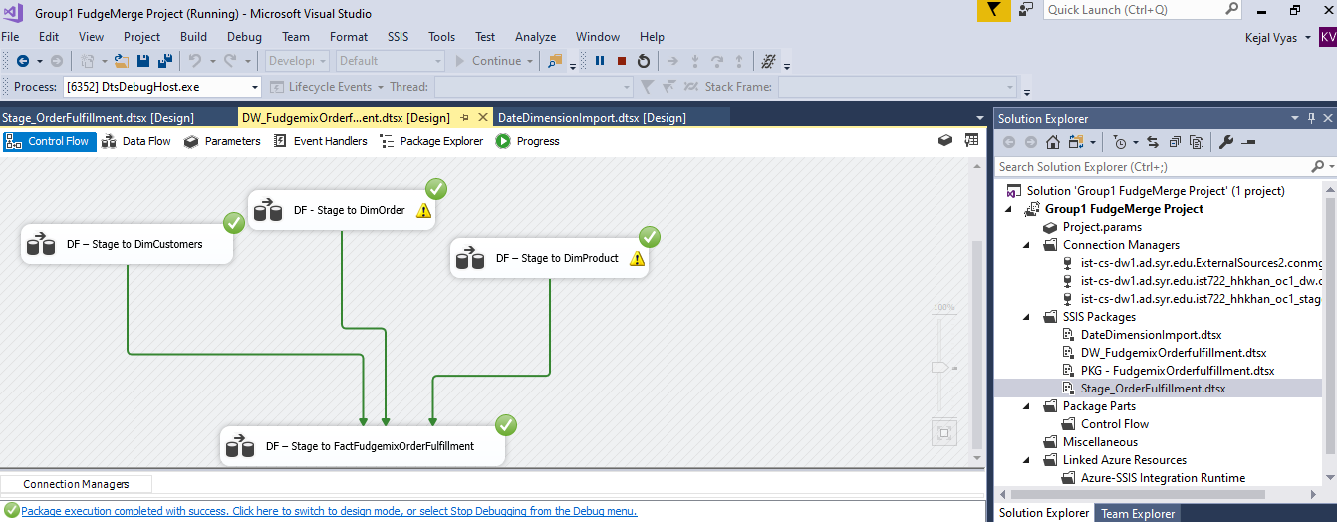
ETL Documentation ScreenShots – DW tables

Slide 11
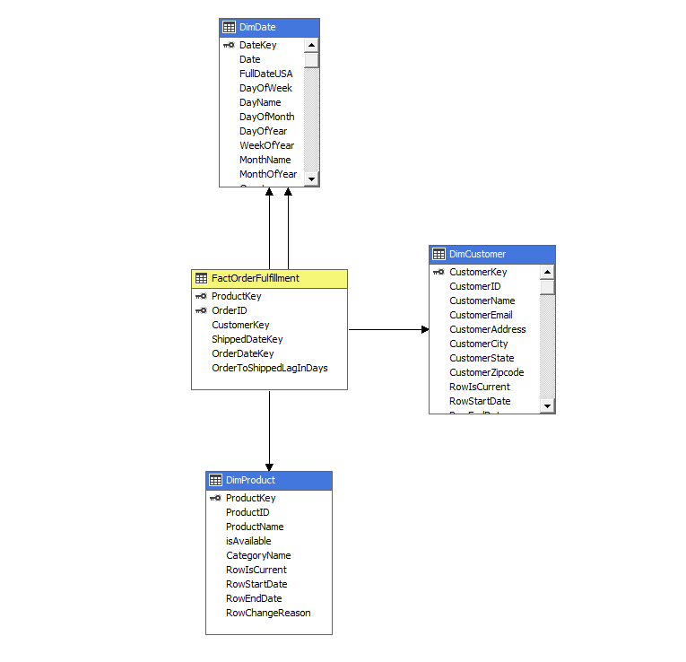
Order Fulfillment Star Schema

Slide 12
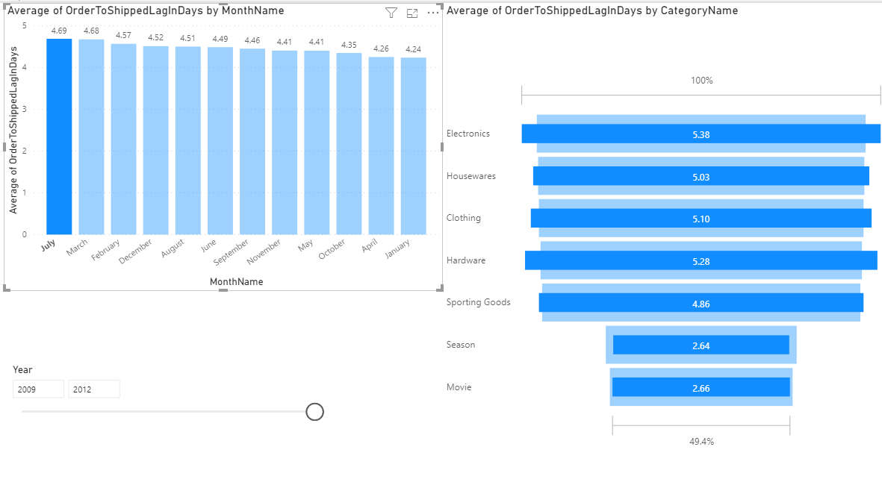
Which Months had the Highest Average Fulfillment Time? Which Categories had the Highest Average Fulfillment Time During this Time?

Slide 13
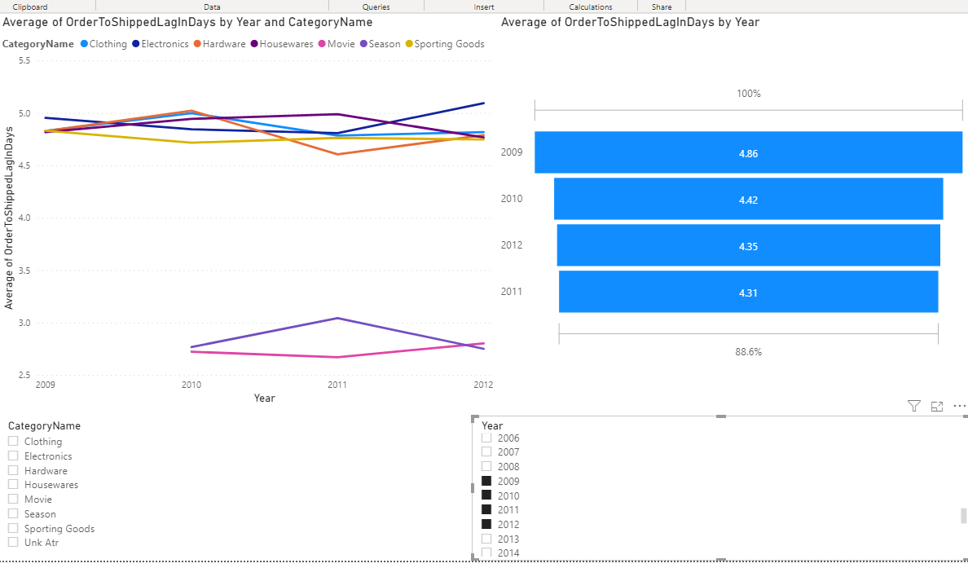
Average Order Fulfillment Time by Year
2013 was excluded as 2013 data only goes up to February.
The average across all of Fudgemix is skewed prior to 2010 since FudgeFlix has no data prior to 2010.

Slide 14
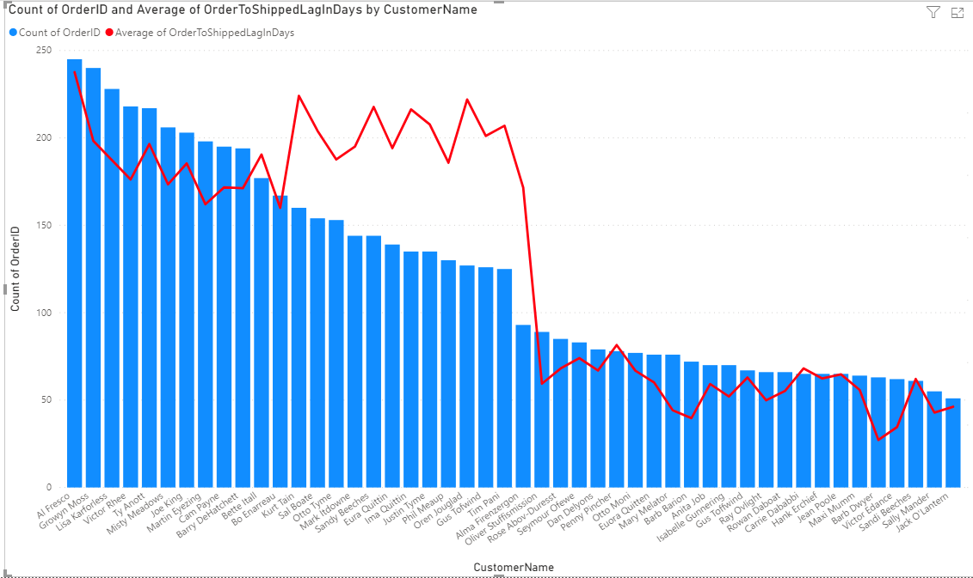
Total Orders by Customer and Average Order Fulfillment Time

Slide 15
Insights and Recommendations
July had the highest average fulfillment time at 4.69 days and January was the lowest at 4.24.
Fudgeflix data only starts in 2010.
The average fulfillment time for moves is approximately 3 days shorter than those of products. This dramatically lowered the average time from 2010 and on.
There does not appear to be any correlation between where a customer is located and the average lag time. The North East has both high and low counts of total orders and lag time, for example.
Order fulfillment time seems to have a direct relation with purchasing power. The more orders a client had, the slightly higher average fulfillment time.

Slide 16
Project Reflection
Learned how to design scalable data storage solutions
Implemented ETL pipeline in Visual Studio
Utilized least permissions principle for DB access
Leveraged Power BI for descriptive and prescriptive analytics

Slide 17
IST 707 – Data Analytics
Pokémon Statistic Prediction
Wesley Stevens

Slide 18


Motivation
There is a large market of Pokemon trainers that want to
Catch them all
Battle Pokemon
Pokémon statistics are critical to both, but difficult and time consuming to determine

Slide 19
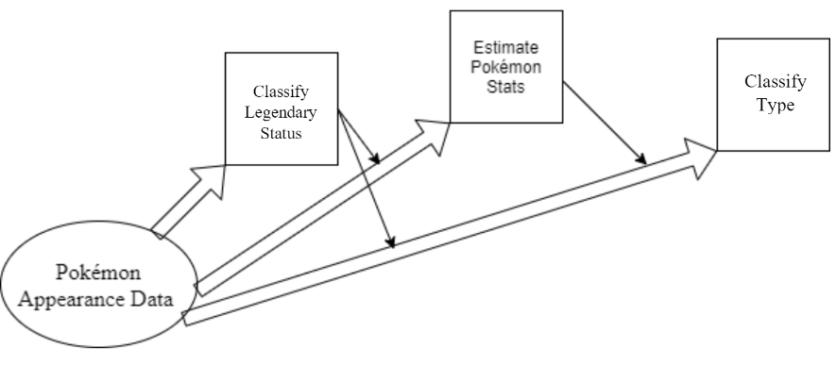
Proposed Solution
Replace the Pokédex scanner by utilizing machine learning
Inputs are visual attributes
Outputs are Pokémon statistics

Slide 20
The Data
Each statistic for each Pokémon can be modeled by a gaussian distribution and is between 1 and 255
Attributes of interest include
Type – Categorical 18 Categories. 1 or 2 Types allowed
HP - Float
Attack - Float
Defense - Float
Speed - Float
IsLegendary – Boolean
Visual Attributes include
Color – Categorical
Body Style – Categorical
Height - Float
Weight - Float

Slide 21
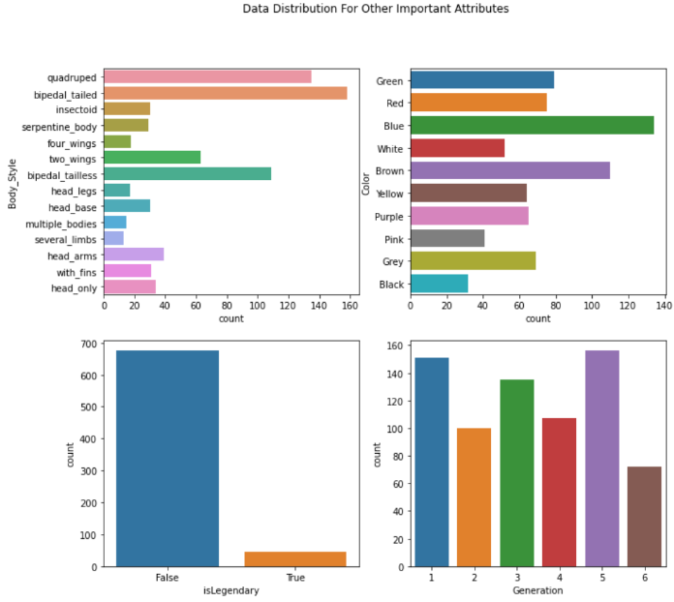
Distribution of Data
Most Pokémon are bipedal and have a tail
Most Pokémon are not Legendary
Most Pokémon are blue
Pokémon are easily differentiated by generation
Most Pokémon are Normal typed
The Second Pokémon type is most often flying

Slide 22
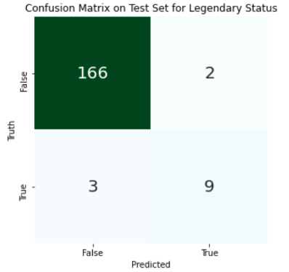
Legendary Status Classification
Best performance was achieved with an XGBoost model
Metric | Score
Accuracy | 97.2%
Precision | 90%
Recall | 86.9%
F1 Score | 88.4%

Slide 23
Base Statistic Regression
Comparison of Regression Models using MSE
7-fold Cross validation
Linear Regression is typically the best suited
 | HP | Speed | Attack | Defense | Sp Attack | Sp Defense
XGBoost | 0.007582 | 0.029 | 0.02118 | 0.014497 | 0.03314 | 0.014675
Linear Regression | 0.007038 | 0.025981 | 0.023484 | 0.012285 | 0.02905 | 0.014259
SVM Regression | 0.007597 | 0.024273 | 0.024655 | 0.012877 | 0.031679 | 0.014614

Slide 24
Pokemon Type Classification
SVM performed the best
7-fold Cross validation
Primary Type | Precision | Recall | F1 Score
Average | 88.8% | 87.9% | 87.3%
Weighted Average | 83.3% | 85.0% | 83.4%
Secondary Type | Precision | Recall | F1 Score
Average | 86.8% | 84.0% | 84.8%
Weighted Average | 82.1% | 83.3% | 82.2%

Slide 25


Speed
While the Pokedex took about 5.5 seconds, the AI replacement only took 0.13 seconds on average

Slide 26
Project Conclusion
We’ve successfully predicted all statistics of an encountered Pokémon based solely on its appearance at 83% - 97% accuracy
Pokémon battle enthusiasts will be able to find the best Pokémon faster
Pokémon trainers will be able to identify the statistics of encountered Pokémon before spending any resources to catch it with reasonable confidence

Slide 27
Project Reflection
Utilized data exploration and transformation to avoid pitfalls
Built end-to-end pipeline that’s only missing a user interface
Leveraged multiple models for predictive analytics

Slide 28
IST 664 - Natural Language Processing
Natural Language Generation Comparison
Wesley Stevens

Slide 29
Overview
NLG (Natural Language Generation) is the field of creating text generating systems
Gained traction through Markov Chains, but is now done mostly through complex neural networks
I will compare a (near) state of the art (GPT-2) with the first promising algorithm (Markov Chains)

Slide 30
The Data
6 Charles Dickens books pulled from Project Gutenberg used for training
A Tale of Two Cities
Our Mutual Friend
Oliver Twist
A Christmas Carol
Bleak House
The Pickwick Papers
The data was cleaned, tokenized, and fed through each algorithm word by word

Slide 31
No Prompt Language Generation
Markov Chain
GPT-2
Though recalled first, attained to duty wine-shop lithe contents night.
Herself a an tread recalled mail recalled first matters years to belief.
Newyear’s contents the lord jackal mail second I first sea.
He sat at his desk, and looked down at the floor, and watched the faces.
Some of his friends came and sat down, so that the next shadows appeared from the corner of a corner, where there were still a few takes, and some of them turned to look round for the other.
When the women who were looking in on her looked up at her in the morning, and said, “I was looking down the street,” she went on: “I was looking at a woman who looked down the street for herself.”

Slide 32
Single Word Prompt: And
Markov Chain
GPT-2
And gloom wine-shop life drawn life I coincidence chapter period shadows years still outhouse contents shoemaker secret age.
And later the description later night hundreds contents the boot shadows the some took two.
And looked and looked, for the sternest time, and for the most exquisite time, and the most beautiful and happy and beautiful.
And as they thought, perhaps for the first time were going to go on looking at each other’s faces the same way, and perhaps for the second to go on looking at them that way for the first time.

Slide 33
Phrase Prompt: It had been a long time
Markov Chain
GPT-2
It had been a long time is opposite nine of sentencing contents I shoemaker book to lately people a smear the blackheath.
It had been a long time loom book wine-shop thread book’s their honest picture the dim preparation first scarcely belief book picture golden the lies thread shadows the mrs.
It had been a long time. Mr. Carus, with his wife and myself here, was the first one who looked at me, and wanted to take me home by my side, and I was much more than he could have expected
It had been a long time, to be sure, the lady who had taken the paper on was an old woman herself, of a very high complexion and very long hair. But there were certain features of that hair, that were not noticed, but there were certain features that were.

Slide 34
Ethics of NLG
Great application for automating menial tasks
Using NLG for automating authorship
Faking authenticity through writership
Censoring language of NLG systems

Slide 35
Project Reflection
Utilized fringe technology to deliver insights
Inspected technology applicability in relation to ethics
Leveraged NLP techniques to wrangle difficult data types

Slide 36
Presentation Conclusion
Demonstrated skills in a few major practice areas in data science
Collected and organized data
Identified patterns in data through visualization and analysis
Developed alternative strategies based on the data
Data-driven decision making in a business setting
Synthesized the ethical dimensions of data science
Demonstrated communication skills

Slide 37
Thank you for watching!

